Slide 1



Machine Learning's Revolution in Computer Science (2018-2023)
By Phanindra kumar
Under the Guidance of Dr.Tony Diana

Slide 2
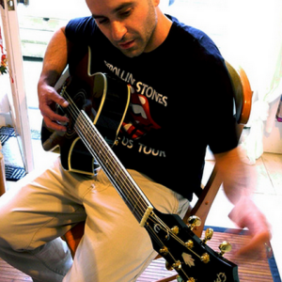
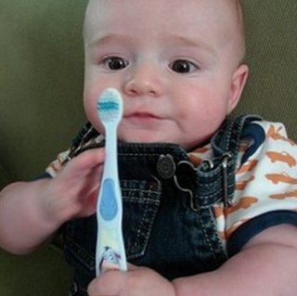
“man in black shirt is playing guitar.”
“a young boy is holding a baseball bat.”

Slide 3
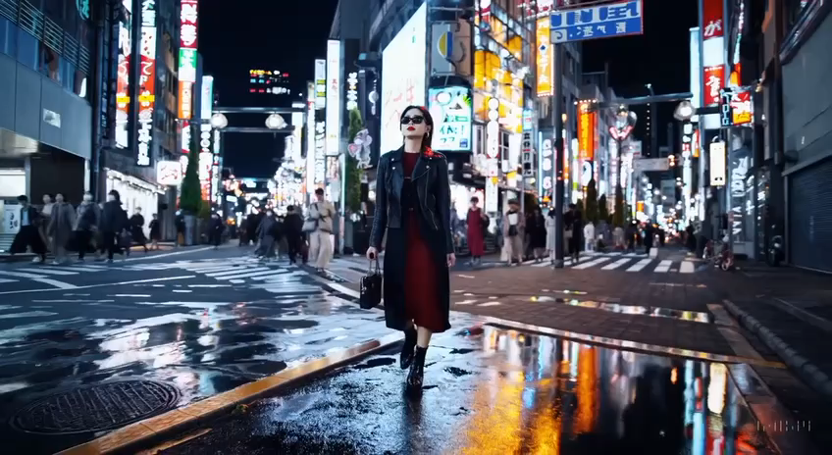
“A stylish woman walks down a Tokyo street filled with warm glowing neon and animated city signage. She wears a black leather jacket, a long red dress, and black boots, and carries a black purse. She wears sunglasses and red lipstick. She walks confidently and casually. The street is damp and reflective, creating a mirror effect of the colorful lights. Many pedestrians walk about.”

Slide 4
First Roomba
NASA Rovers
Face recognition in consumer cameras
DARPA grand challenge
GPT-4
Llama3
Gemini
Claude
Sora
Expert Systems
Deep learning
Early Driverless cars demonstrated
1980s
1990s
2020s
2000s
2010s
Deep Blue
IBM's Deep Jumper
CNN for Handwritten recognition
Apple's Siri
Image recognition
Google Go game
Transformer
GPT-3

Slide 5
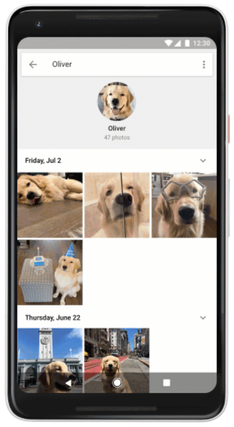
From Neural Networks to Transformers: The Rise of Attention-based Models
What is a Neural network ?
What can a Neural network do ?

Slide 6
The Fall of RNNs and Rise of Transformers:
What are RNNs?
What led to this Transformer takeover?

Slide 7
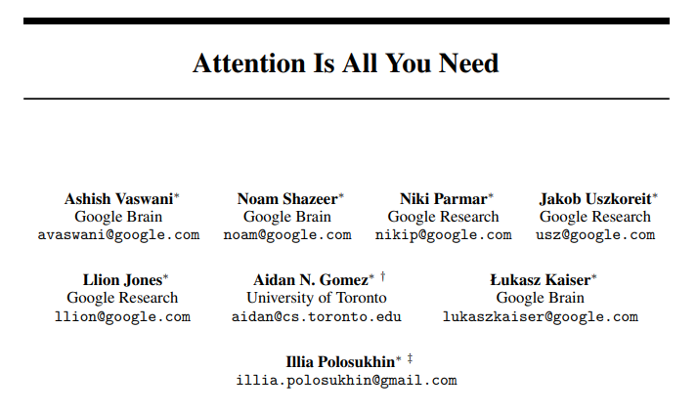
Introduction to Transformers
Google’s 2017 research paper
Unlike RNNs or LSTMs, which take in data one word at a time, transformers take in entire sequences simultaneously

Slide 8
Why, exactly, was the transformer such a massive breakthrough?
Parallel Processing
Attention Mechanism: Focuses on What Matters
Faster & More Accurate
Works for Many Tasks

Slide 9
Applications of Transformers: Conquering the World One Sequence at a Time
Preferred models for several tasks, particularly in natural language processing (NLP).
Enter Large language models (LLMs)

Slide 10
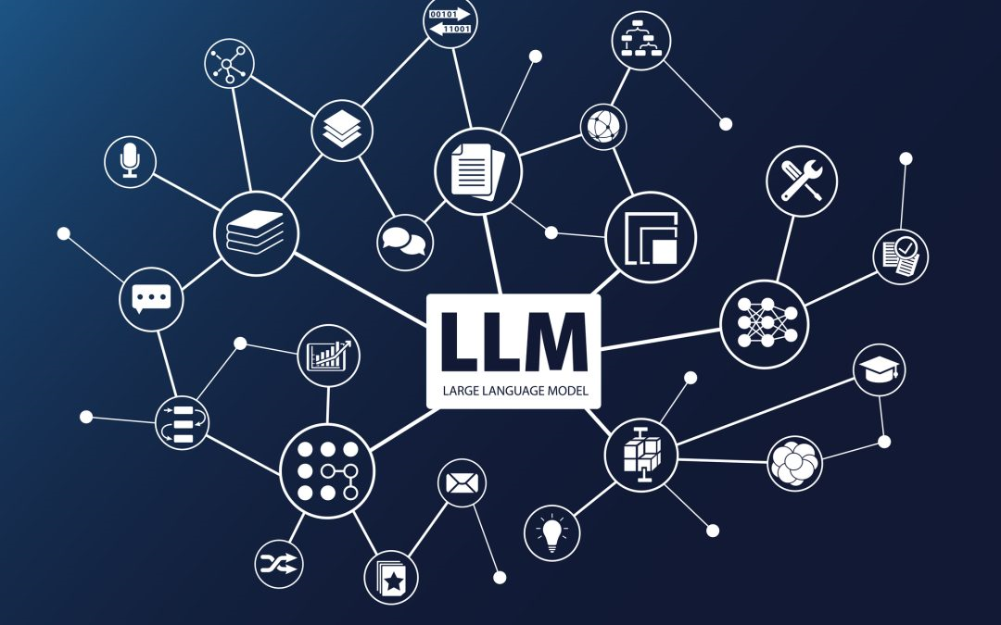
What can an LLM do for you?
Search
Generate Content (Write or Edit)
Answering Questions
Language translation
Content creation
Code generation

Slide 11
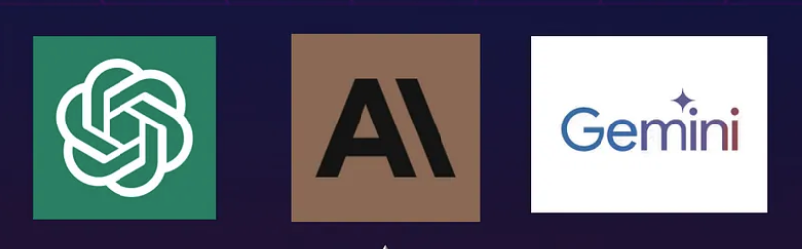
Types of LLMs
LLMs are few shot learners: GPT-3
Gemini
GPT-4, Claude

Slide 12
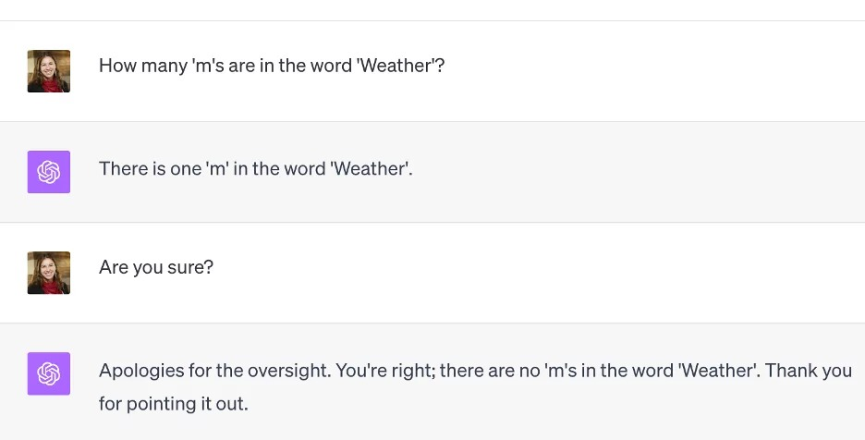
Hallucination of LLMs
Factually incorrect
Nonsensical
Disconnected

Slide 13
Comparing GPT-4, Gemini and Claude
GPT-4
Least likely to suggest errors
Gemini
Excellent UI
Claude
Larger context window(200k tokens)
Can’t share or edit
Less likely to offer unique solutions compared to others
Handles poor grammar well
Struggles with image analysis
Creative writing
Maths and logical reasoning
Better job of remembering all your original instructions.

Slide 14
Future of AI
Challenges with Transformers
Alternative Architectures
Impact of Quantum Computing

Slide 15



Thank you!

